Slide 1
Azure Data Warehouse In-A-Day
02. SQL DW Gen-2 – Planning your Build
Steve Young - Data & AI CSA
Rebecca Young - Data & AI CSA
Notes:
This deck get into designing and building
Go over some very key items you need to think about , then how to plan and build your DW

Slide 2
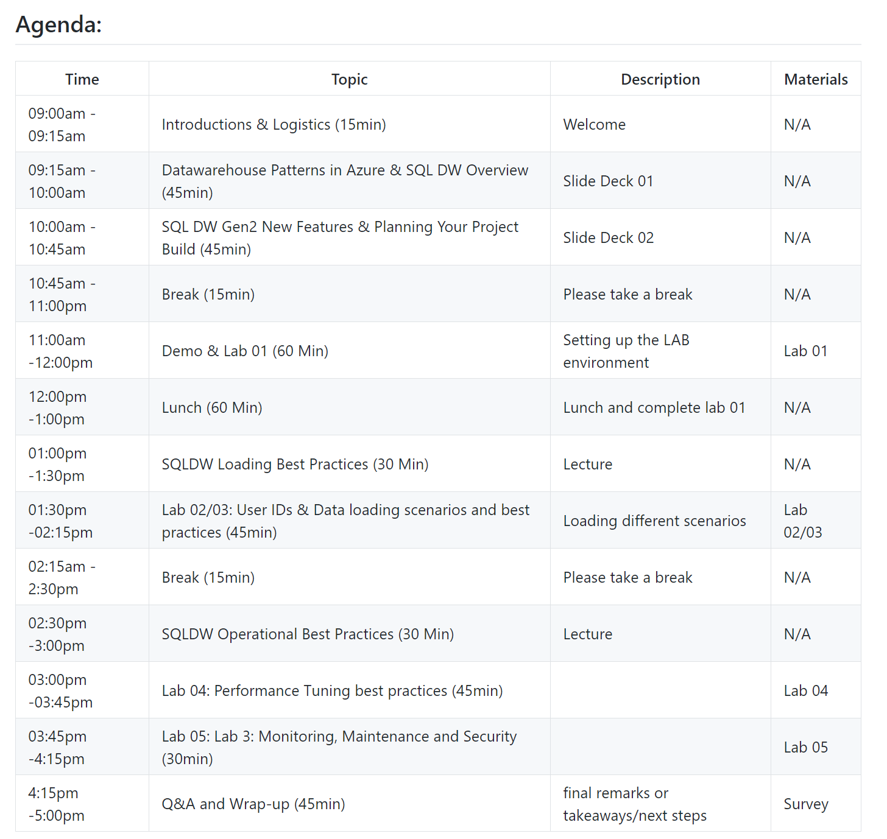
Agenda
Notes:
Quickly go through Test Cases to refresh everyone and relate them to agenda topics for the day

Slide 3
Azure SQL Data Warehouse Gen 2 - Performance Features
Notes:
Who has used Gen 2? Or Gen 1

Slide 4
Data Movement
https://azure.microsoft.com/en-us/blog/smarter-faster-safer-azure-sql-data-warehouse-is-simply-unmatched/
Notes:
Data Movement – The Query Killer

Slide 5
Data Movement - Instant Data Movement (IDM)
Instant Data Movement (IDM) - extremely efficient movement between data warehouse compute nodes.
At the heart of every distributed database system is the need to align two or more tables
That are partitioned on a different key to produce a final or intermediate result set.
Notes:
All about minimizing data movement
You will have data movement, but minimizing it is the best

Slide 6
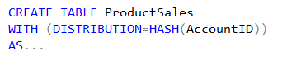
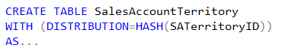
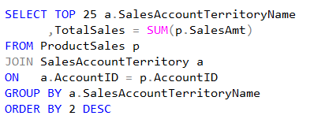
Distributed Data Movement
ProductSales
SalesAccountTerritory
AccountID | SalesAmt | …
47 | $1,234.36 | …
36 | $2,345.47 | …
14 | $3,456.58 | …
25 | $4,567.69 | …
48 | $5,678.70 | …
37 | $6,789.81 | …
… | … | …
SATerritoryID | AccountID | …
444 | 37 | …
333 | 25
111 | 36 | …
222 | 47 | …
445 | 14
334 | 48 | …
… | … | …
Node 1:
Node 2:
Node 3:
Node 4:
Node 5:
Node 6:
Shuffle
SATName | TotalSales
North | $6,789.81
South | $5,678.70
NorthEast | $4,567.69
SouthWest | $3,456.58
East | $2,345.47
West | $1,234.36
AccountID | SATName | …
47 | West | …
36 | East
14 | SouthWest | …
25 | NorthEast | …
48 | South
37 | North | …
… | … | …
Notes:
Data Movement – The Query Killer

Slide 7
Gen2 – instant data movement
SQL DW Compute Node 2
SQL Engine
Distributed Tables
SQL DW Compute Node 1
TEMP DB
SQL Engine
Distributed Tables
TEMP DB
SQL DW Compute Node 3
SQL Engine
Distributed Tables
Data does not leave SQL Engine
Batch-mode: minimal overhead
Scalable: leverages all cores and network
TEMP DB

Slide 8
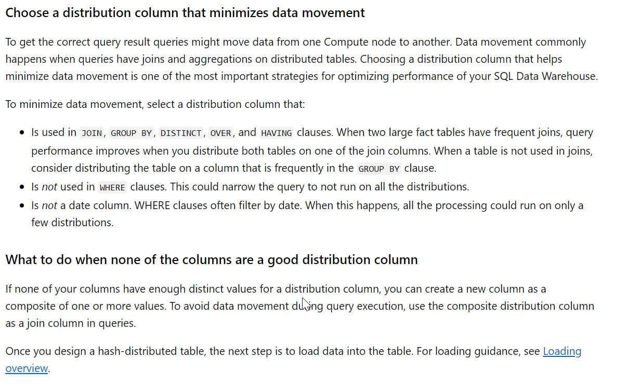
Distribution Column
Notes:
All about minimizing data movement

Slide 9
Resource Classes

Slide 10
Gen2 – Simpler resource model
With Gen2, dynamic resource pools were introduced with a 3-10-22-70 model for resource allocations.
Instead of choosing from 8 resource pools, they are calculated on the fly per service level.
Resource Class | Percent Resources
SmallRc | 3%
MediumRc | 10%
LargeRc | 22%
XLargeRc | 70%
Resource Class | Percent Resources | Concurrency
SmallRc | 3% | 32
MediumRc | 10% | 10
LargeRc | 22% | 4
XLargeRc | 70% | 1
EXEC sp_addrolemember 'largerc', 'loaduser';

Slide 11
Gen2 – Simpler model
At MediumRc, an example…
MediumRC |  | Gen1 Model |  | Gen2 Model
Service Level | Total Slots | Slots | Concurrency | Slots | Concurrency
DW1000c | 40 | 8 | 5 | 4 | 10
DW1500c | 60 | 8 | 7 | 6 | 10
DW2000c | 80 | 16 | 5 | 8 | 10
DW2500c | 100 | 16 | 6 | 10 | 10
DW3000c | 120 | 16 | 7 | 12 | 10
DW5000c | 200 | 32 | 6 | 20 | 10
DW6000c | 240 | 32 | 7 | 24 | 10
DW7500c | 300 | 64 | 4 | 30 | 10
DW10000c | 400 | 64 | 6 | 40 | 10
DW15000c | 600 | 64 | 9 | 60 | 10
DW30000c | 1200 | 64 | 18 | 120 | 10

Slide 12
Workload Management

Slide 13




WORKLOAD IMPORTANCE – no importance
Scheduler without importance
Overview
CEO
CEO
CEO
Workload importance allows you to prioritize the queries that get access to resources. It helps ensure that high-business value work is executed first on a busy data warehouse.
1
2
3
9
4
5
10
6
7
8
10
9
11
12
10
11
12
Running
Queued
Queued
Queued
Notes:
Talking Points:
Use the ALTER DATABASE statement to enable the query store.
ALTER DATABASE Databasename SET QUERY_STORE = ON;
Query Store catalog views:
sys.database_query_store_options (Transact-SQL)
sys.query_context_settings (Transact-SQL)
sys.query_store_plan (Transact-SQL)
sys.query_store_query (Transact-SQL)
sys.query_store_query_text (Transact-SQL)
sys.query_store_runtime_stats (Transact-SQL)
sys.query_store_runtime_stats_interval (Transact-SQL)
Query Store stored procedures:
sp_query_store_flush_db (Transact-SQL)
sp_query_store_force_plan (Transact-SQL)
sp_query_store_remove_plan (Transct-SQL)
sp_query_store_remove_query (Transact-SQL)
sp_query_store_reset_exec_stats (Transact-SQL)
sp_query_store_unforce_plan (Transact-SQL)

Slide 14
WORKLOAD CLASSIFICATION
Overview
CREATE WORKLOAD CLASSIFIER classifier_name
WITH
(
[WORKLOAD_GROUP = '<Resource Class>' ]
[IMPORTANCE = { LOW |
BELOW_NORMAL |
NORMAL |
ABOVE_NORMAL |
HIGH
}
]
[MEMBERNAME = ‘security_account’]
)
Allows you to map a query to an allocation of resources via pre-determined rules
Use this in combination with workload importance to effectively share resources across different workload types
Notes:
Talking Points:
Use the ALTER DATABASE statement to enable the query store.
ALTER DATABASE Databasename SET QUERY_STORE = ON;
Query Store catalog views:
sys.database_query_store_options (Transact-SQL)
sys.query_context_settings (Transact-SQL)
sys.query_store_plan (Transact-SQL)
sys.query_store_query (Transact-SQL)
sys.query_store_query_text (Transact-SQL)
sys.query_store_runtime_stats (Transact-SQL)
sys.query_store_runtime_stats_interval (Transact-SQL)
Query Store stored procedures:
sp_query_store_flush_db (Transact-SQL)
sp_query_store_force_plan (Transact-SQL)
sp_query_store_remove_plan (Transct-SQL)
sp_query_store_remove_query (Transact-SQL)
sp_query_store_reset_exec_stats (Transact-SQL)
sp_query_store_unforce_plan (Transact-SQL)

Slide 15

WORKLOAD IMPORTANCE –importance
Scheduler with Importance
Overview
CEO
CEO
Workload importance allows you to prioritize the queries that get access to resources. It helps ensure that high-business value work is executed first on a busy data warehouse.
1
2
3
12
4
5
6
7
8
9
10
11
12
Normal
Low
Normal
High
Running
Queued
Queued
Notes:
Talking Points:
Use the ALTER DATABASE statement to enable the query store.
ALTER DATABASE Databasename SET QUERY_STORE = ON;
Query Store catalog views:
sys.database_query_store_options (Transact-SQL)
sys.query_context_settings (Transact-SQL)
sys.query_store_plan (Transact-SQL)
sys.query_store_query (Transact-SQL)
sys.query_store_query_text (Transact-SQL)
sys.query_store_runtime_stats (Transact-SQL)
sys.query_store_runtime_stats_interval (Transact-SQL)
Query Store stored procedures:
sp_query_store_flush_db (Transact-SQL)
sp_query_store_force_plan (Transact-SQL)
sp_query_store_remove_plan (Transct-SQL)
sp_query_store_remove_query (Transact-SQL)
sp_query_store_reset_exec_stats (Transact-SQL)
sp_query_store_unforce_plan (Transact-SQL)

Slide 16
WORKLOAD isolation (Preview)
Overview
CREATE WORKLOAD GROUP group_name
WITH
(
[ MIN_PERCENTAGE_RESOURCE = value ]
[ CAP_PERCENTAGE_RESOURCE = value ]
[ MAX_CONCURRENCY = value ]
)
Isolation allocates fixed resources to workloads within a data warehouse. These limits are strictly enforced for memory, and only enforced under load for CPU and IO.
Resource classes are implemented by assigning users to database roles. When a user runs a query, the query runs with the user's resource class
EXEC sp_addrolemember 'largerc', 'loaduser’;
EXEC sp_droprolemember 'largerc', 'loaduser';
https://docs.microsoft.com/en-us/azure/sql-data-warehouse/sql-data-warehouse-workload-classification
Notes:
Talking Points:
Use the ALTER DATABASE statement to enable the query store.
ALTER DATABASE Databasename SET QUERY_STORE = ON;
Query Store catalog views:
sys.database_query_store_options (Transact-SQL)
sys.query_context_settings (Transact-SQL)
sys.query_store_plan (Transact-SQL)
sys.query_store_query (Transact-SQL)
sys.query_store_query_text (Transact-SQL)
sys.query_store_runtime_stats (Transact-SQL)
sys.query_store_runtime_stats_interval (Transact-SQL)
Query Store stored procedures:
sp_query_store_flush_db (Transact-SQL)
sp_query_store_force_plan (Transact-SQL)
sp_query_store_remove_plan (Transct-SQL)
sp_query_store_remove_query (Transact-SQL)
sp_query_store_reset_exec_stats (Transact-SQL)
sp_query_store_unforce_plan (Transact-SQL)

Slide 17
DW Creation Framework Architecture Decisions

Slide 18
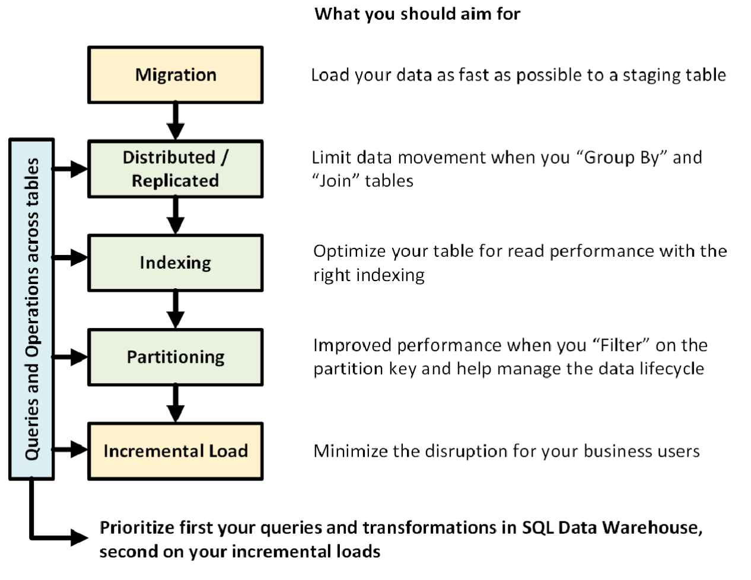
DW Creation Framework Architecture Decisions “Improve your probability of Success!!!!!”
https://docs.microsoft.com/en-us/azure/sql-data-warehouse/cheat-sheet

Slide 19


Hub & Spoke Architecture for Analytics (BI)
INGEST
STORE
PREP & TRAIN
MODEL & SERVE
Data Marts
Business/custom apps
(structured)
SQL
Azure Databricks
Multiple Azure SQL Database instances
Logs (unstructured)
PolyBase
Azure Data Factory
Azure Blob Storage
Azure SQL Data Warehouse
Power BI
Flat Files
Media (unstructured)
Data Cubes
Multiple Azure Analysis Services instances
Files (unstructured)
Microsoft Azure supports other services like Azure HDInsight and Azure Data Lake in various layers to allow customers a truly customized solution.

Slide 20

Choose a Light House Project
Don’t let your first project be your last !!!
Get Comfortable with the technology – Kick the tires
Take a smaller project, treat like a production roll out.
Provides insights not only about the technology, but the organization’s maturity in being able to do a data project
Can the Input Files be generated, Tested, Errors traced
Handle change management
If you don’t measure, how do you know if you succeeded? Failed?
This Photo by Unknown Author is licensed under CC BY-SA

Slide 21
DW Creation Framework

Slide 22


Data Warehouse Workflow
Inspire
Design - Sources
Design SQL Architecture
Operate
Imagine a future state solution and develop use cases and query patterns
Discovery the source data and plan for ELT/ETL Process
Empower others in your organization to see the value
Achieve business outcomes and improved customer experiences
Solution Design
Identify Data Process
Solution
Demonstration
Operation

Slide 23
Data Warehouse Design workflow
Inspire - Project Goals and Definitions
Design - Identify Data Sources
Identify Data Migration techniques
Design - SQL DW Tables
Indexing Patterns
Partitioning
Data Architecture and Flow
Incremental Load
External Table Definitions
Staging Tables
Queries and Table Joins
Security / Access Users / Resource Classes
Operations
Production Tables
Migration Pipelines
Distribution and Replicated
Indexing Patterns
Query Performance

Slide 24
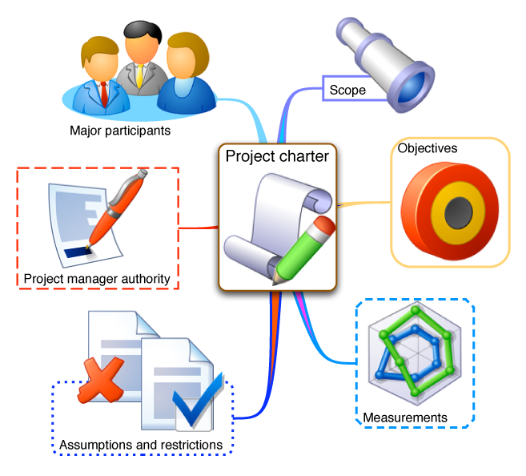
workflow – Project Goals and Definitions
Imagine a future state solution and develop use cases and query patterns
Data Architecture and Flow - Identification
What sources are to be used
What format should they take
What is the update pattern
Queries and Table Joins
Capture existing queries, reports and ad-hoc analysis
Security / Access Users / Priorities (Resource Classes)
This Photo by Unknown Author is licensed under CC BY-SA-NC

Slide 25
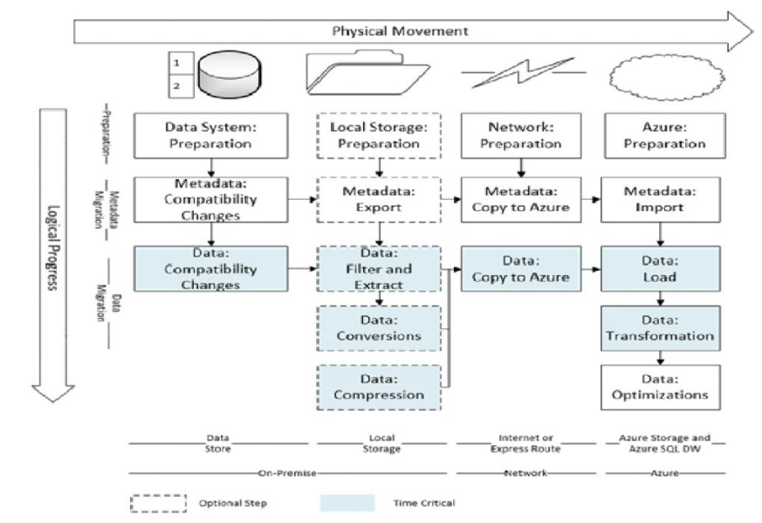
workflow – Identify Data Sources
Imagine a future state solution and develop use cases and query patterns
Identify Data Migration tasks
File formats
Update schedule
Incremental Load
Are these required?
Migration Pipelines
Azure Data Factory
Azure Data Lake / Blob storage
https://blogs.msdn.microsoft.com/sqlcat/2016/08/18/migrating-data-to-azure-sql-data-warehouse-in-practice/
https://techcommunity.microsoft.com/t5/DataCAT/Azure-SQL-Data-Warehouse-loading-patterns-and-strategies/ba-p/305456
Notes:
There is help https://blogs.msdn.microsoft.com/sqlcat/2017/05/17/azure-sql-data-warehouse-loading-patterns-and-strategies/
Go to link

Slide 26
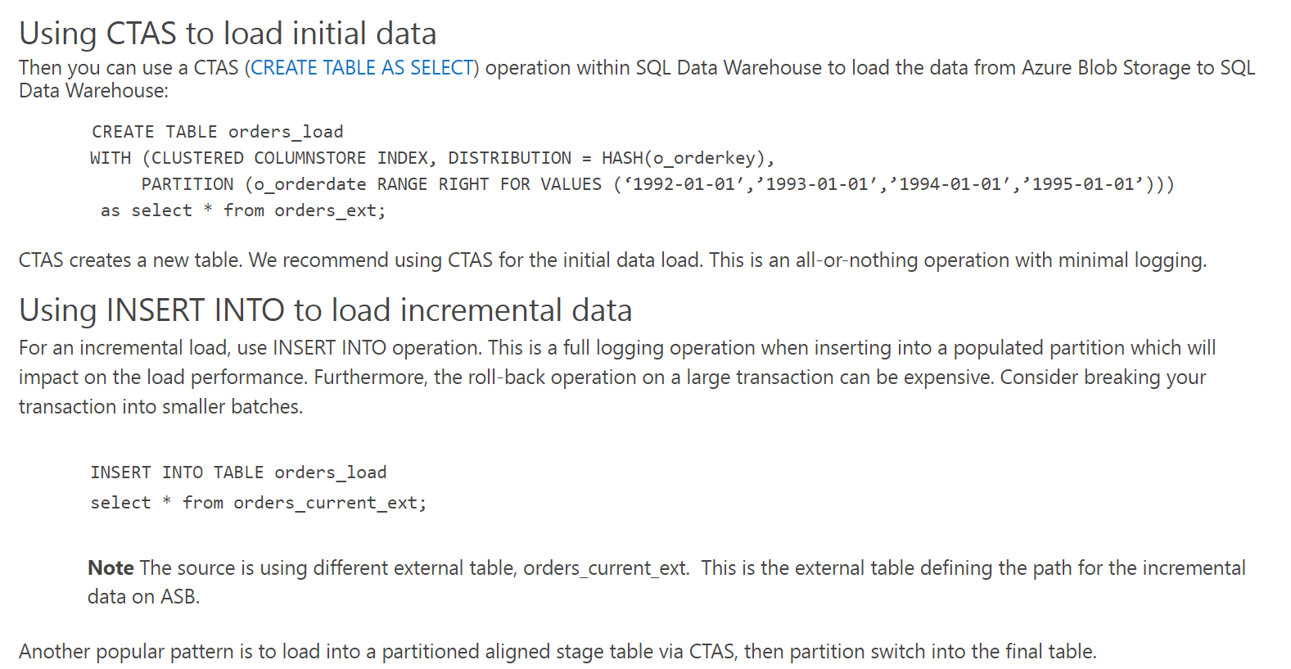
workflow – Identify Data Sources
Imagine a future state solution and develop use cases and query patterns
https://techcommunity.microsoft.com/t5/DataCAT/Azure-SQL-Data-Warehouse-loading-patterns-and-strategies/ba-p/305456
Notes:
There is help https://blogs.msdn.microsoft.com/sqlcat/2017/05/17/azure-sql-data-warehouse-loading-patterns-and-strategies/
Go to link

Slide 27



WORKFLOW – IDENTIFY DATA SOURCES
This is Key !!!!
Unknown Value Data
XML
High Value Data
JSON
TEXT
Model
Load
Transform
Aggregate
Consume
Data Preparation
Pre-process
Transpose
Re-format
Batch
Ad-hoc
Batch
Parquet
Notes:
High Data Value is the key point.

Slide 28
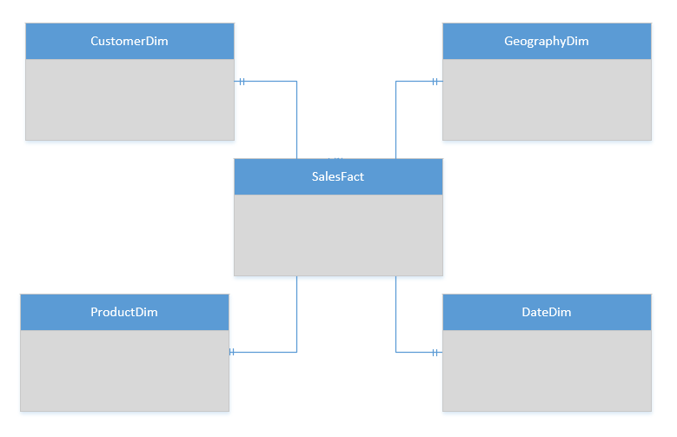
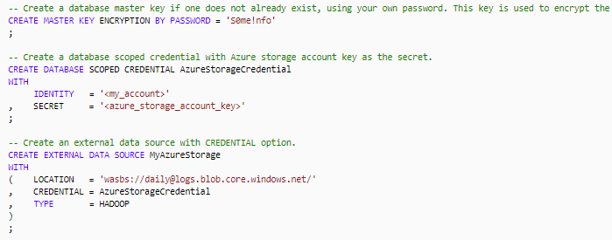
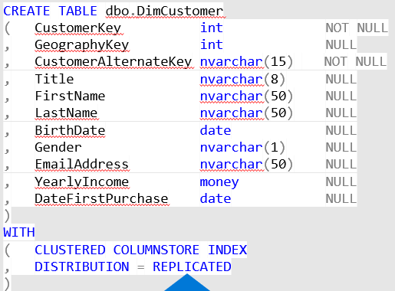
workflow – Design SQL DW Tables
Imagine a future state solution and develop use cases and query patterns
External Table Definitions
Staging Tables
Production Tables
Indexing Patterns
Partitioning
Distribution and Replicated

Slide 29
workflow – Operations
Imagine a future state solution and develop use cases and query patterns
Indexing Patterns
Query Performance
Data Management Views

Slide 30
Q&A

Slide 31
SQL Datawarehouse Architecture

Slide 32
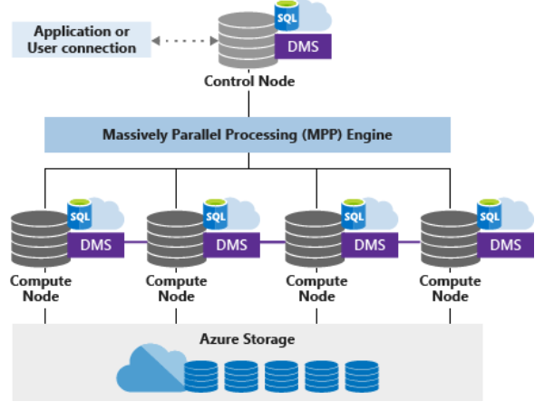
Architecture - Overview
Decoupled Storage allows:
Independently size compute power irrespective of your storage needs.
Grow or shrink compute power without moving data.
Pause compute capacity while leaving data intact, so you only pay for storage.
Resume compute capacity during operational hours.
Reference - https://docs.microsoft.com/en-us/azure/sql-data-warehouse/massively-parallel-processing-mpp-architecture

Slide 33
Architecture - Overview
Overview
SQL Data Warehouse uses a node-based architecture.
Applications connect and issue T-SQL commands to a Control node, single point of entry
The Control node runs the MPP engine which optimizes queries for parallel processing, and then passes operations to Compute nodes to do their work in parallel.
The Compute nodes store all user data in Azure Storage and run the parallel queries.
The Data Movement Service (DMS) moves data across the nodes as necessary to run queries in parallel and return accurate results.

Slide 34
Architecture – Azure Storage
Overview
Data is stored and managed by Azure storage
The data itself is sharded into distributions to optimize the performance of the system. You can choose which sharding pattern to use to distribute the data when you define the table. SQL Data Warehouse supports these sharding patterns:
Hash
Round Robin
Replicate

Slide 35
Architecture – Control Node
Overview
The brain of the data warehouse
The front end that interacts with all applications and connections.
MPP engine runs on the Control node to optimize and coordinate parallel queries.
The Control node transforms a submit a T-SQL query into queries that run against each distribution in parallel.

Slide 36
Architecture – Compute Nodes
Overview
Provide the computational power.
Distributions map to Compute nodes for processing.
Scale Up compute resources, SQL Data Warehouse re-maps the distributions to the available Compute nodes which ranges from 1 to 60
Each Compute node has a node ID that is visible in system views. https://docs.microsoft.com/en-us/sql/relational-databases/system-catalog-views/sql-data-warehouse-and-parallel-data-warehouse-catalog-views?view=aps-pdw-2016-au7

Slide 37
Architecture – Data Movement Service
Overview
The data transport technology that coordinates data movement between the Compute nodes.
Some queries require data movement to ensure the parallel queries return accurate results.

Slide 38
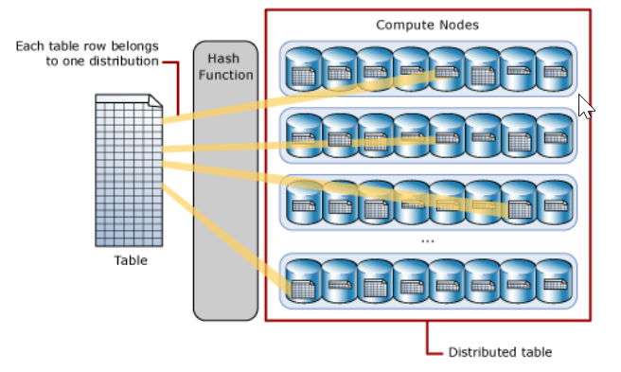
Architecture – Table Distributions
Hash Table Distributions
A hash distributed table can deliver the highest query performance for joins and aggregations on large tables.
Uses a hash function to deterministically assign each row to one distribution.
In the table definition, one of the columns is designated as the distribution column.
The hash function uses the values in the distribution column to assign each row to a distribution.

Slide 39
Architecture – Table Distributions
Round-robin distributed Table Distributions
Round-robin table is the simplest table to create and delivers fast performance when used as a staging table for loads.
A round-robin distributed table distributes data evenly across the table but without any further optimization.
Query performance can often be better with hash distributed tables.
Joins on round-robin tables require reshuffling data and this takes additional time.

Slide 40
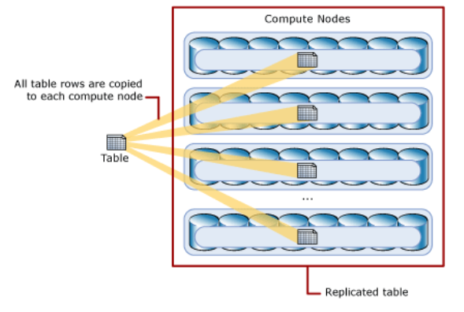
Architecture – Table Distributions
Round-robin distributed Table Distributions
A replicated table provides the fastest query performance for small tables.
A table that is replicated caches a full copy of the table on each compute node. Consequently, replicating a table removes the need to transfer data among compute nodes before a join or aggregation. Replicated tables are best utilized with small tables. Extra storage is required and there is additional overhead that is incurred when writing data which make large tables impractical.

Slide 41
Performance Details Resources
Gen2 GA
Turbocharge cloud analytics with Azure SQL Data Warehouse
Blazing fast data warehousing with Azure SQL Data Warehouse
Adaptive Caching
Adaptive caching powers Azure SQL Data Warehouse performance gains
Instant data movement
Lightning fast query performance with Azure SQL Data Warehouse
GigaOm Benchmarking Report
https://gigaom.com/report/data-warehouse-in-the-cloud-benchmark/

Slide 42
Result-set caching
Performance Optimizations > Result-set Caching
Public Preview H2 CY19
Overview
Cache the results of a query in DW storage. This enables interactive response times for repetitive queries against tables with infrequent data changes.
The result-set cache persists even if a data warehouse is paused and resumed later.
Query cache is invalidated and refreshed when underlying table data or query code changes.
Result cache is evicted regularly based on a time-aware least recently used algorithm (TLRU).
-- Turn on/off result-set caching for a database
-- Must be run on the MASTER database
ALTER DATABASE {database_name}
SET RESULT_SET_CACHING { ON | OFF }
-- Turn on/off result-set caching for a client session
-- Run on target data warehouse
SET RESULT_SET_CACHING {ON | OFF}
-- Check result-set caching setting for a database
-- Run on target data warehouse
SELECT is_result_set_caching_on
FROM sys.databases
WHERE name = {database_name}
-- Return all query requests with cache hits
-- Run on target data warehouse
SELECT *
FROM sys.dm_pdw_request_steps
WHERE command like '%DWResultCacheDb%'
AND step_index = 0
Notes:
Result-set caching
The maximum size of the result-set cache is 1TB
Query results are persisted for a maximum of 48 hours but can be evicted earlier to save space based on the least recently used result
Disabled on DW by default unless turned on at a session level or the entire database level
Additional storage costs are incurred by caching query result sets
Check the is_result_set_caching column in the sys.databases DMV to show the result-set caching setting for a database
Users can tell if a query was executed with a result cache hit or miss by querying sys.pdw_request_steps for commands where value is like ‘%DWResultCacheDb%’

Slide 43


Result-set caching flow
Performance Optimizations > Result-set Caching
Public Preview H2 CY19
01010100010100101010
01010100010100101010
1
Client sends query to DW
2
Query is processed using DW compute nodes which pull data from remote storage, process query and output back to client app
3
Query results are cached in remote storage so subsequent requests can be served immediately
01010100010100101010
4
Subsequent executions for the same query bypass compute nodes and can be fetched instantly from persistent cache in remote storage
5
Remote storage cache is evicted regularly based on time, cache usage, and any modifications to underlying table data.
6
Cache will need to be regenerated if query results have been evicted from cache
Notes:
Result-set caching
The maximum size of the result-set cache is 1TB
Query results are persisted for a maximum of 48 hours but can be evicted earlier to save space based on the least recently used result
Disabled on DW by default unless turned on at a session level or the entire database level
Additional storage costs are incurred by caching query result sets
Check the is_result_set_caching column in the sys.databases DMV to show the result-set caching setting for a database
Users can tell if a query was executed with a result cache hit or miss by querying sys.pdw_request_steps for commands where value is like ‘%DWResultCacheDb%’

Slide 44
Indexed (materialized) views
Performance Optimizations > Indexed (materialized) views
Public Preview H2 CY19
-- Create indexed view
CREATE INDEXED VIEW Sales.vw_Orders
WITH
(
DISTRIBUTION = ROUND_ROBIN |
HASH(ProductID)
)
AS
SELECT SUM(UnitPrice*OrderQty) AS Revenue, OrderDate,
ProductID,
COUNT_BIG(*) AS OrderCount
FROM Sales.SalesOrderDetail
GROUP BY OrderDate, ProductID;
GO
-- Disable index view and put it in suspended mode
ALTER INDEX ALL ON Sales.vw_Orders DISABLE;
-- Re-enable index view by rebuilding it
ALTER INDEX ALL ON Sales.vw_Orders REBUILD;
Overview
Indexed views cache the schema and data for a view in DW remote storage. They are useful for improving the performance of ‘SELECT’ statement queries that include aggregations
Indexed views are automatically updated when data in underlying tables are changed. This is a synchronous operation that occurs as soon as the data is changed.
The auto caching functionality allows SQL DW Query Optimizer to consider using indexed view even if the view is not referenced in the query.
Supported aggregations: MAX, MIN, AVG, COUNT, COUNT_BIG, SUM, VAR, STDEV
Notes:
Current Limitations:
If MIN/MAX aggregates are used in the SELECT list, the indexed view will automatically be disabled when UPDATE and DELETE occur in the referenced base tables. Run ALTER INDEX with REBUILD to re-enable the indexed view
Only INNER JOIN is supported
Only HASH and ROUND_ROBIN distributions are supported
Only CLUSTERED COLUMNSTORE INDEX is supported
ALTER VIEW is not supported

Slide 45
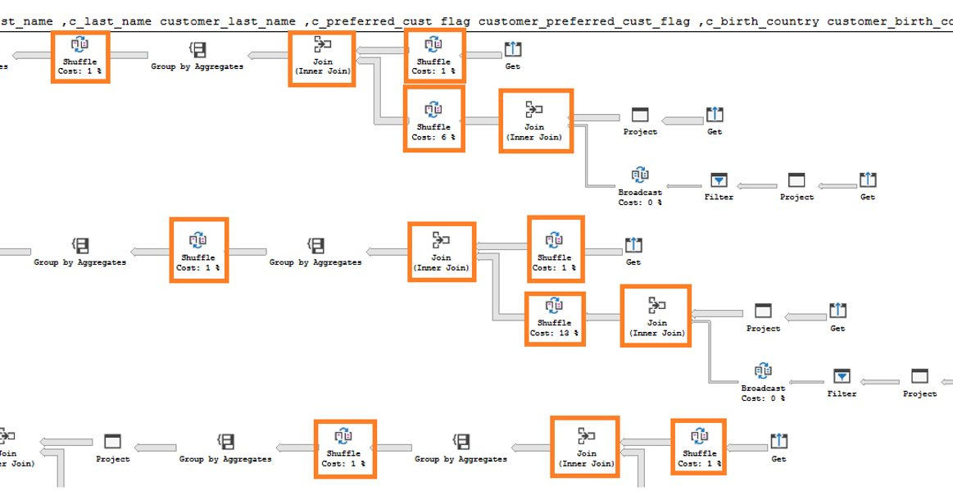
Indexed (materialized) views - example
Performance Optimizations > Indexed (materialized) views > Example
Public Preview H2 CY19
In this example, a query to get the year total sales per customer is shown to have a lot of data shuffles and joins that contribute to slow performance:
Execution time: 103 seconds Lots of data shuffles and joins needed to complete query
No relevant indexed views created on the data warehouse
-- Get year total sales per customer
(WITH year_total AS
SELECT customer_id,​
first_name,​
last_name,
birth_country, login,
email_address​,
d_year,
SUM(ISNULL(list_price – wholesale_cost – discount_amt + sales_price, 0)/2)year_total​
FROM customer cust
JOIN catalog_sales sales ON cust.sk = sales.sk
JOIN date_dim ON sales.sold_date = date_dim.date
GROUP BY customer_id​, first_name​, last_name​,birth_country​, login​,email_address​ ,d_year​
)
SELECT TOP 100 …
FROM year_total …
WHERE …
ORDER BY …

Slide 46
Indexed (materialized) views - example
Performance Optimizations > Indexed (materialized) views > Example
Public Preview H2 CY19
Now, we add an indexed view to the data warehouse to increase the performance of the previous query. This view can be leveraged by the query even though it is not directly referenced.
Original query – get year total sales per customer
Create indexed view with hash distribution on customer_id column
-- Get year total sales per customer
(WITH year_total AS
SELECT customer_id,​
first_name,​
last_name,
birth_country, login,
email_address​,
d_year,
SUM(ISNULL(list_price – wholesale_cost – discount_amt + sales_price, 0)/2)year_total​
FROM customer cust
JOIN catalog_sales sales ON cust.sk = sales.sk
JOIN date_dim ON sales.sold_date = date_dim.date
GROUP BY customer_id​, first_name​, last_name​,birth_country​, login​,email_address​ ,d_year​
)
SELECT TOP 100 …
FROM year_total …
WHERE …
ORDER BY …
-- Create indexed view for query
CREATE INDEXED VIEW nbViewCS WITH (DISTRIBUTION=HASH(customer_id)) AS
SELECT customer_id,​
first_name,​
last_name,
birth_country, login,
email_address​,
d_year,
SUM(ISNULL(list_price – wholesale_cost – discount_amt +
sales_price, 0)/2) AS year_total​
FROM customer cust
JOIN catalog_sales sales ON cust.sk = sales.sk
JOIN date_dim ON sales.sold_date = date_dim.date
GROUP BY customer_id​, first_name​,
last_name​,birth_country​,
login​, email_address​, d_year​

Slide 47
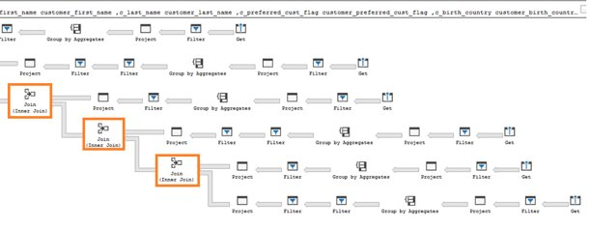
Indexed (materialized) views - example
Performance Optimizations > Indexed (materialized) views > Example
Public Preview H2 CY19
The SQL Data Warehouse query optimizer automatically leverages the indexed view to speed up the same query. Notice that the query does not need to reference the view directly
Execution time: 6 seconds Optimizer leverages materialized view to reduce data shuffles and joins needed
Original query – no changes have been made to query
-- Get year total sales per customer
(WITH year_total AS
SELECT customer_id,​
first_name,​
last_name,
birth_country, login,
email_address​,
d_year,
SUM(ISNULL(list_price – wholesale_cost – discount_amt + sales_price, 0)/2)year_total​
FROM customer cust
JOIN catalog_sales sales ON cust.sk = sales.sk
JOIN date_dim ON sales.sold_date = date_dim.date
GROUP BY customer_id​, first_name​, last_name​,birth_country​, login​,email_address​ ,d_year​
)
SELECT TOP 100 …
FROM year_total …
WHERE …
ORDER BY …

Slide 48
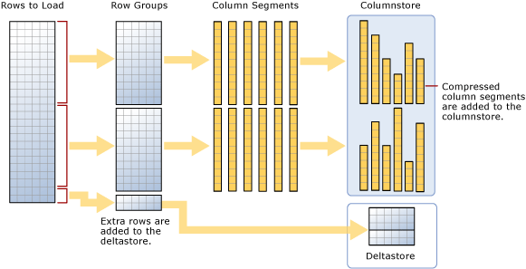
Ordered Columnstore Segments
Performance Optimizations > Clustered Columnstore Index > Ordered Columnstore Segments
Private Preview H2 2019
-- Create Table with Ordered Columnstore Index
CREATE TABLE sortedOrderTable
(
OrderId INT NOT NULL,
Date DATE NOT NULL,
Name VARCHAR(2),
Country VARCHAR(2)
)
WITH
(
CLUSTERED COLUMNSTORE INDEX ORDER (OrderId)
)
-- Create Clustered Columnstore Index on existing table
CREATE CLUSTERED COLUMNSTORE INDEX cciOrderId
ON dbo.OrderTable ORDER (OrderId)
-- Insert data into table with ordered columnstore index
INSERT INTO sortedOrderTable
VALUES (1, '01-01-2019','Dave’, 'UK')
Overview
Queries against tables with ordered columnstore segments can take advantage of improved segment elimination to drastically reduce the time needed to service a query.
Columnstore Segments are automatically updated as data is inserted, updated, or deleted in data warehouse tables.

Slide 49
JSON data support – insert JSON data
Analytics > JSON data support
Public Preview
Overview
The JSON format enables representation of complex or hierarchical data structures in tables.
JSON data is stored using standard NVARCHAR table columns.
-- Create Table with column for JSON string
CREATE TABLE CustomerOrders
(
CustomerId BIGINT NOT NULL,
Country NVARCHAR(150) NOT NULL,
OrderDetails NVARCHAR(3000) NOT NULL –- NVARCHAR column for JSON
) WITH (DISTRIBUTION = ROUND_ROBIN)
-- Populate table with semi-structured data
INSERT INTO CustomerOrders
VALUES
( 101, -- CustomerId
'Bahrain', -- Country
N'[{ StoreId": "AW73565",
"Order": { "Number":"SO43659",
"Date":"2011-05-31T00:00:00"
},
"Item": { "Price":2024.40, "Quantity":1 }
}]’ -- OrderDetails
)

Slide 50
JSON data support – read JSON data
Analytics > JSON data support
Public Preview
Overview
Read JSON data stored in a string column with the following:
ISJSON – verify if text is valid JSON
JSON_VALUE – extract a scalar value from a JSON string
JSON_QUERY – extract a JSON object or array from a JSON string
-- Return all rows with valid JSON data
SELECT CustomerId, OrderDetails
FROM CustomerOrders
WHERE ISJSON(OrderDetails) > 0;
CustomerId | OrderDetails
101 | N'[{ StoreId": "AW73565", "Order": { "Number":"SO43659", "Date":"2011-05-31T00:00:00“ }, "Item": { "Price":2024.40, "Quantity":1 }}]'
-- Extract values from JSON string
SELECT CustomerId,
Country,
JSON_VALUE(OrderDetails,'$.StoreId') AS StoreId,
JSON_QUERY(OrderDetails,'$.Item') AS ItemDetails
FROM CustomerOrders;
CustomerId | Country | StoreId | ItemDetails
101 | Bahrain | AW73565 | { "Price":2024.40, "Quantity":1 }

Slide 51
JSON data support – modify and operate on JSON data
Analytics > JSON data support
Public Preview
Overview
Use standard table columns and values from JSON text in the same analytical query.
Modify JSON data with the following:
JSON_MODIFY – modifies a value in a JSON string
OPENJSON – convert JSON collection to a set of rows and columns
-- Modify Item Quantity value
UPDATE CustomerOrders SET OrderDetails =
JSON_MODIFY(OrderDetails, '$.OrderDetails.Item.Quantity',2)
OrderDetails
N'[{ StoreId": "AW73565", "Order": { "Number":"SO43659", "Date":"2011-05-31T00:00:00“ }, "Item": { "Price":2024.40, "Quantity": 2}}]'
-- Convert JSON collection to rows and columns
SELECT CustomerId,
StoreId,
OrderDetails.OrderDate,
OrderDetails.OrderPrice
FROM CustomerOrders
CROSS APPLY OPENJSON (CustomerOrders.OrderDetails)
WITH ( StoreId VARCHAR(50) '$.StoreId',
OrderNumber VARCHAR(100) '$.Order.Date',
OrderDate DATETIME '$.Order.Date',
OrderPrice DECIMAL ‘$.Item.Price',
OrderQuantity INT '$.Item.Quantity'
) AS OrderDetails
CustomerId | StoreId | OrderDate | OrderPrice
101 | AW73565 | 2011-05-31T00:00:00 | 2024.40

Slide 52
Windowing functions
Analytics > Windowing functions
SELECT
ROW_NUMBER() OVER(PARTITION BY PostalCode ORDER BY SalesYTD DESC
) AS "Row Number",
LastName,
SalesYTD,
PostalCode
FROM Sales
WHERE SalesYTD <> 0
ORDER BY PostalCode;
OVER clause
Defines a window or specified set of rows within a query result set
Computes a value for each row in the window
Aggregate functions
COUNT, MAX, AVG, SUM, APPROX_COUNT_DISTINCT, MIN, STDEV, STDEVP, STRING_AGG, VAR, VARP, GROUPING, GROUPING_ID, COUNT_BIG, CHECKSUM_AGG
Analytical functions
LAG, LEAD, FIRST_VALUE, LAST_VALUE, CUME_DIST, PERCENTILE_CONT, PERCENTILE_DISC, PERCENT_RANK
Ranking functions
RANK, NTILE, DENSE_RANK, ROW_NUMBER
ROWS | RANGE
PRECEDING, UNBOUNDING PRECEDING, CURRENT ROW, BETWEEN, FOLLOWING, UNBOUNDED FOLLOWING
Row Number | LastName | SalesYTD | PostalCode
1 | Mitchell | 4251368.5497 | 98027
2 | Blythe | 3763178.1787 | 98027
3 | Carson | 3189418.3662 | 98027
4 | Reiter | 2315185.611 | 98027
5 | Vargas | 1453719.4653 | 98027
6 | Ansman-Wolfe | 1352577.1325 | 98027
1 | Pak | 4116870.2277 | 98055
2 | Varkey Chudukaktil | 3121616.3202 | 98055
3 | Saraiva | 2604540.7172 | 98055
4 | Ito | 2458535.6169 | 98055
5 | Valdez | 1827066.7118 | 98055
6 | Mensa-Annan | 1576562.1966 | 98055
7 | Campbell | 1573012.9383 | 98055
8 | Tsoflias | 1421810.9242 | 98055

Slide 53
Approximate execution
Analytics > Approximate execution
HyperLogLog accuracy
Will return a result with a 2% accuracy of true cardinality on average.
e.g. COUNT (DISTINCT) returns 1,000,000, HyperLogLog will return a value in the range of 999,736 to 1,016,234.
APPROX_COUNT_DISTINCT
Returns the approximate number of unique non-null values in a group.
Use Case: Approximating web usage trend behavior
-- Syntax
APPROX_COUNT_DISTINCT ( expression )
-- The approximate number of different order keys by order status from the orders table.
SELECT O_OrderStatus, APPROX_COUNT_DISTINCT(O_OrderKey) AS Approx_Distinct_OrderKey
FROM dbo.Orders
GROUP BY O_OrderStatus
ORDER BY O_OrderStatus;

Slide 54
Group by options
Analytics > Group by options
Public Preview Apr’2019
Group by with rollup
Creates a group for each combination of column expressions.
Rolls up the results into subtotals and grand totals.
Grouping sets
Combine multiple GROUP BY clauses into one GROUP BY CLAUSE.
Equivalent of UNION ALL of specified groups.
-- GROUP BY ROLLUP Example --
SELECT Country,
Region,
SUM(Sales) AS TotalSales
FROM Sales
GROUP BY ROLLUP (Country, Region);
-- Results --
-- GROUP BY SETS Example --
SELECT Country,
SUM(Sales) AS TotalSales
FROM Sales
GROUP BY GROUPING SETS ( Country, () );
Country | Region | TotalSales
Canada | Alberta | 100
Canada | British Columbia | 500
Canada | NULL | 600
United States | Montana | 100
United States | NULL | 100
NULL | NULL | 700

Slide 55
Databricks – structured streaming
# Prepare streaming source; this could be Kafka, Kinesis, or a simple rate stream.
df = spark.readStream \
.format("rate") \
.option("rowsPerSecond", "100000") \
.option("numPartitions", "16") \
.load()
# Apply some transformations to the data then use
# Structured Streaming API to continuously write the data to a table in SQL DW.
df.writeStream \
.format("com.databricks.spark.sqldw") \
.option("url", <azure-sqldw-jdbc-url>) \
.option("tempDir", "wasbs://<containername>@<storageaccount>.blob.core.windows.net/<directory>") \
.option("forwardSparkAzureStorageCredentials", "true") \
.option("dbTable", <table-name>) \
.option("checkpointLocation", "/tmp_location") \
.start()
Overview
The Databricks SQL DW connector supports batch and structured streaming support for writing real-time data into Azure SQL Data Warehouse.
It uses Polybase and the Databricks structured streaming API to stream data from Kafka, Kinesis sources directly into SQL DW at a user-configurable rate.
Source: https://docs.azuredatabricks.net/spark/latest/data-sources/azure/sql-data-warehouse.html#streaming-support

Slide 56
Since Gen2 GA
05/14/18 Automatic Statistics
06/16/18 User Defined Restore Points
06/21/19 Column-level security
07/25/18 Fast Restore
08/02/18 Recommendations for data skew and table statistics
09/24/18 Streaming support in Azure Databricks
09/24/18 User defined maintenance scheduling
09/24/18 Vulnerability assessment
09/24/18 Intelligent Insights
09/24/18 Flexible Restore Points
11/07/18 RLS
11/12/18 Azure Monitor log support
12/08/18 Azure Virtual Network service endpoints
01/10/19 Azure Data Box Disk
Upcoming Features:
Copy Command
Work Load Management
Notes:
https://azure.microsoft.com/en-us/updates/?product=sql-data-warehouse
Data Box Disk

